Slide 1
Benchmarking Ten Deep Learning Models
for Fine-Grained Video Action Recognition on Something-Something v2
CAP 5610 Final Project, Spring 2026
Munish Persaud, Ayaan Khan, Aiden Letourneau, Kenneth Valladares, Arthur Lookshin
University of Central Florida

Slide 2
Something-Something v2
■ 174 fine-grained action classes
■ 168,913 train / 24,777 val / 27,157 test clips
■ Direction-sensitive labels (no horizontal flip)
If you can tell push left from push right,
you can pass.

Slide 3
Ten architectures, one benchmark
CNN family
Transformer family
Other
- TSM
- R(2+1)D
- SlowFast
- CNN+ConvLSTM
- TimeSformer
- VideoMAE
- VideoMamba (SSM)
- ST-GCN (graph)
- PredRNN (world model)
- Qwen3.5-4B (VLM)
Reference: V-JEPA-2 frozen self-supervised baseline (Meta FAIR)

Slide 4
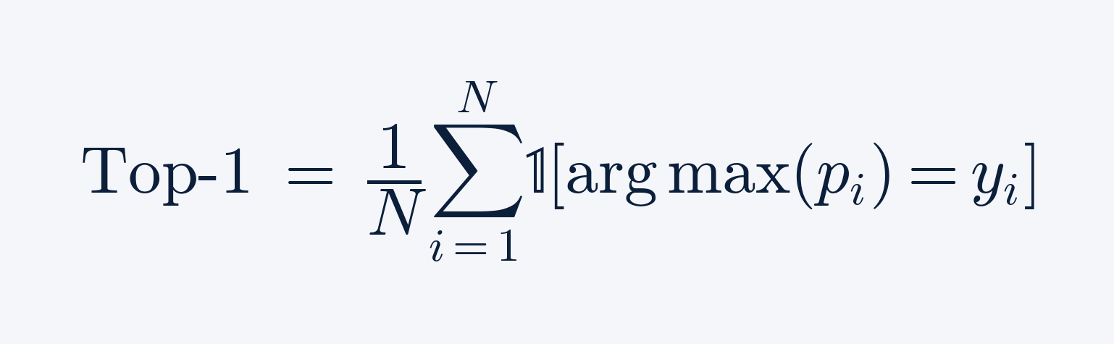
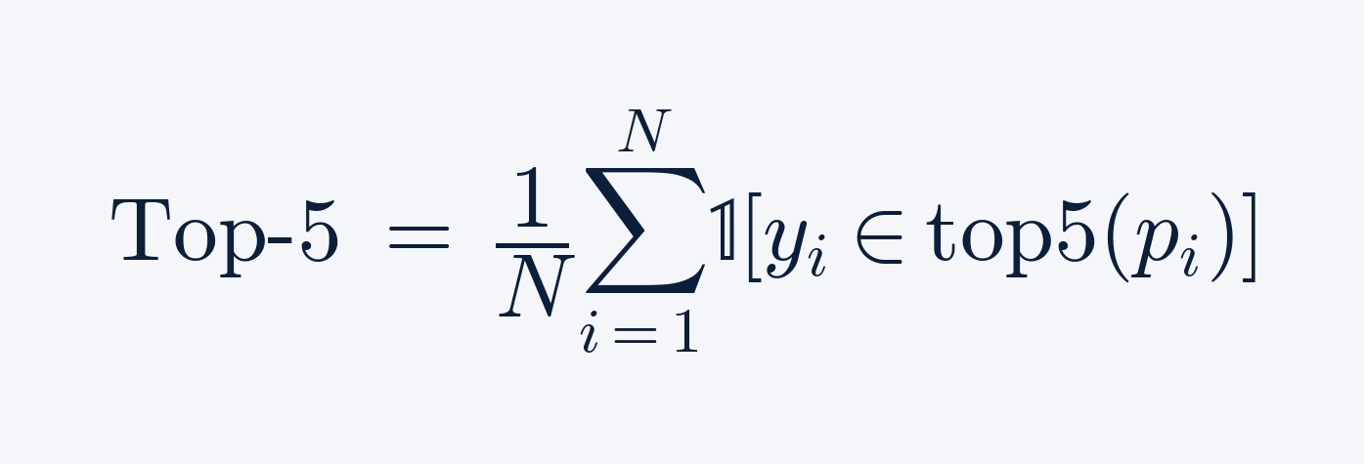
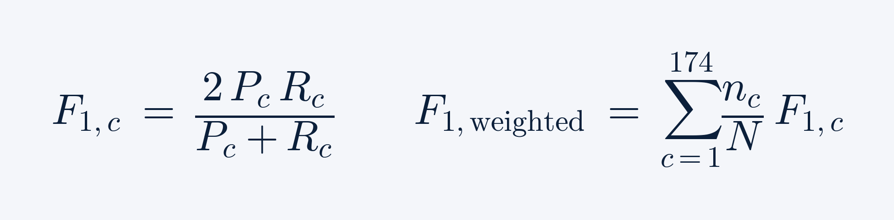
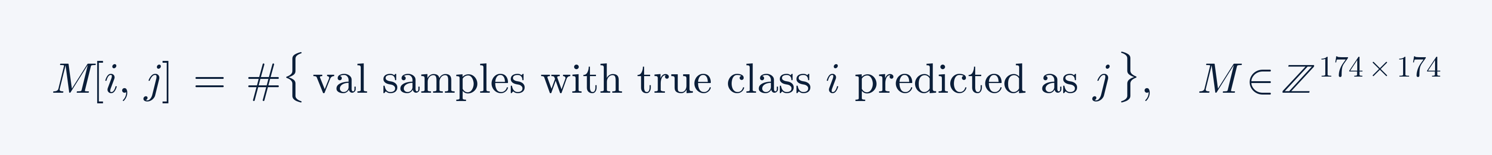
Evaluation metrics
Top-1
Top-5
Weighted F1
Confusion matrix
Caveat: Qwen has no top-5 (generative model, no rank order over the 174 labels).

Slide 5
What got in the way
■ RTX 5090 sm_120 not supported by stable PyTorch builds (SlowFast crashed mid-epoch)
■ Dataloader stalls on webm decoding cost VideoMAE 3-4x throughput
■ Vast.ai migration for Qwen and PredRNN to escape Windows dataloader contention
■ Label ambiguity in SSv2 templates (the 429-confusion Qwen pair)
■ Labels for the dataset hidden by Qualcomm

Slide 6
How we tuned
Common across all models
Model-specific
■ 8 or 16 frames per clip
■ 224 x 224 spatial resolution
■ ImageNet-mean normalization
■ No horizontal flip
■ AdamW or SGD with cosine LR
■ Qwen QLoRA r=16, alpha=32 on q/k/v/o
■ ST-GCN SGD lr 0.1, step decay at 30/40
■ VideoMAE bf16, lr 5e-4
■ TimeSformer bf16, lr 1e-4
■ VideoMamba K400 init, bf16 selective scan

Slide 7
Headline result

Slide 8
Tier 1: V-JEPA, the SSL ceiling
64.51%
■ Frozen ViT-L/16 backbone, frozen attentive probe
■ Meta FAIR pretraining on VideoMix2M plus Meta SSv2 probe
■ 5 points below Meta's 69.5% (V100 + FP16, eval code hardcodes float16)
top-1, eval-only

Slide 9
Tier 2: Qwen3.5-4B with QLoRA
58.19%
■ VLM repurposed via generative classification (model.generate then string-match to 174 labels)
■ Only 3.15M trainable LoRA params (0.12% of 2.59B total)
■ 1 epoch on 168K samples, 43.3 hours on Vast.ai 5090
top-1, 1 epoch QLoRA

Slide 10
Tier 3: VideoMamba and the Bimamba bug fix
1.45% → 53.91%
Top-1 on SSv2, after fixing one silent unidirectional kwarg
■ Pre-bugfix from-scratch run: 1.45% top-1 in 10 epochs
■ Post-bugfix K400-finetuned: 53.91% top-1 in 2 epochs
■ Stopped at 2 epochs because our selective-scan path is 3.5x slower than the fused mamba_inner_fn
■ Conservative extrapolation to 15 epochs: 58 to 62% top-1, above Qwen, approaching V-JEPA

Slide 11
Tier 4: R(2+1)D
46.36%
■ Spatiotemporal-separable 3D convolutions, ImageNet-init R(2+1)D-18
■ 30 epochs, full fine-tune on RTX 5090, 105 hours
■ Sweet spot of cost vs accuracy for a from-scratch trainable model
top-1 / 74.84% top-5

Slide 12
Tier 5: SlowFast and TimeSformer
SlowFast
TimeSformer
36.34%
34.41%
■ Partial run, Blackwell crash mid-epoch
■ K400 init, two pathways (Slow=8, Fast=32)
■ Loss decreasing 5.09 -> 4.58 before crash
■ Top-5 69.34% / F1 0.5734
■ K400 init, 8 frames, 121M params
■ bf16 stable end-to-end, 15 epochs

Slide 13
Tier 6: CNN + ConvLSTM
ResNet-18 backbone (ImageNet) + from-scratch ConvLSTM head. 27.01% top-1, 53.14% top-5, saturates by epoch 14. Strong on camera motion (83.6% on 'turning the camera left').

Slide 14
Tier 7: VideoMAE
16.92%
■ ViT-B/16, K400 self-supervised pretrain, full fine-tune
■ Dataloader stalls capped throughput at 1.74 hr/epoch (vs 0.85 hr predicted)
■ Vast.ai host pause cost 24 hrs of wall-clock, finished at 11/15 epochs
top-1 (11/15 epochs)

Slide 15
Tier 8: TSM
6.27%
■ ResNet-50 with temporal shift in each bottleneck
■ 30 epochs, train acc reached 96% but val stuck around 6%
■ Massive train-val gap, classic overfit, temporal shift alone is not enough on SSv2
top-1 (overfit)

Slide 16
Bottom tier: PredRNN and ST-GCN
PredRNN
ST-GCN
4.67%
3.94%
■ World model from scratch, 18.6M params
■ Picks up motion patterns
■ Misses physical transformations
■ Skeleton-only, 3.1M params
■ 55% MediaPipe pose detection rate
■ SSv2 frames mostly show hands, not bodies
Both fundamentally limited on fine-grained hand-object interactions.

Slide 17
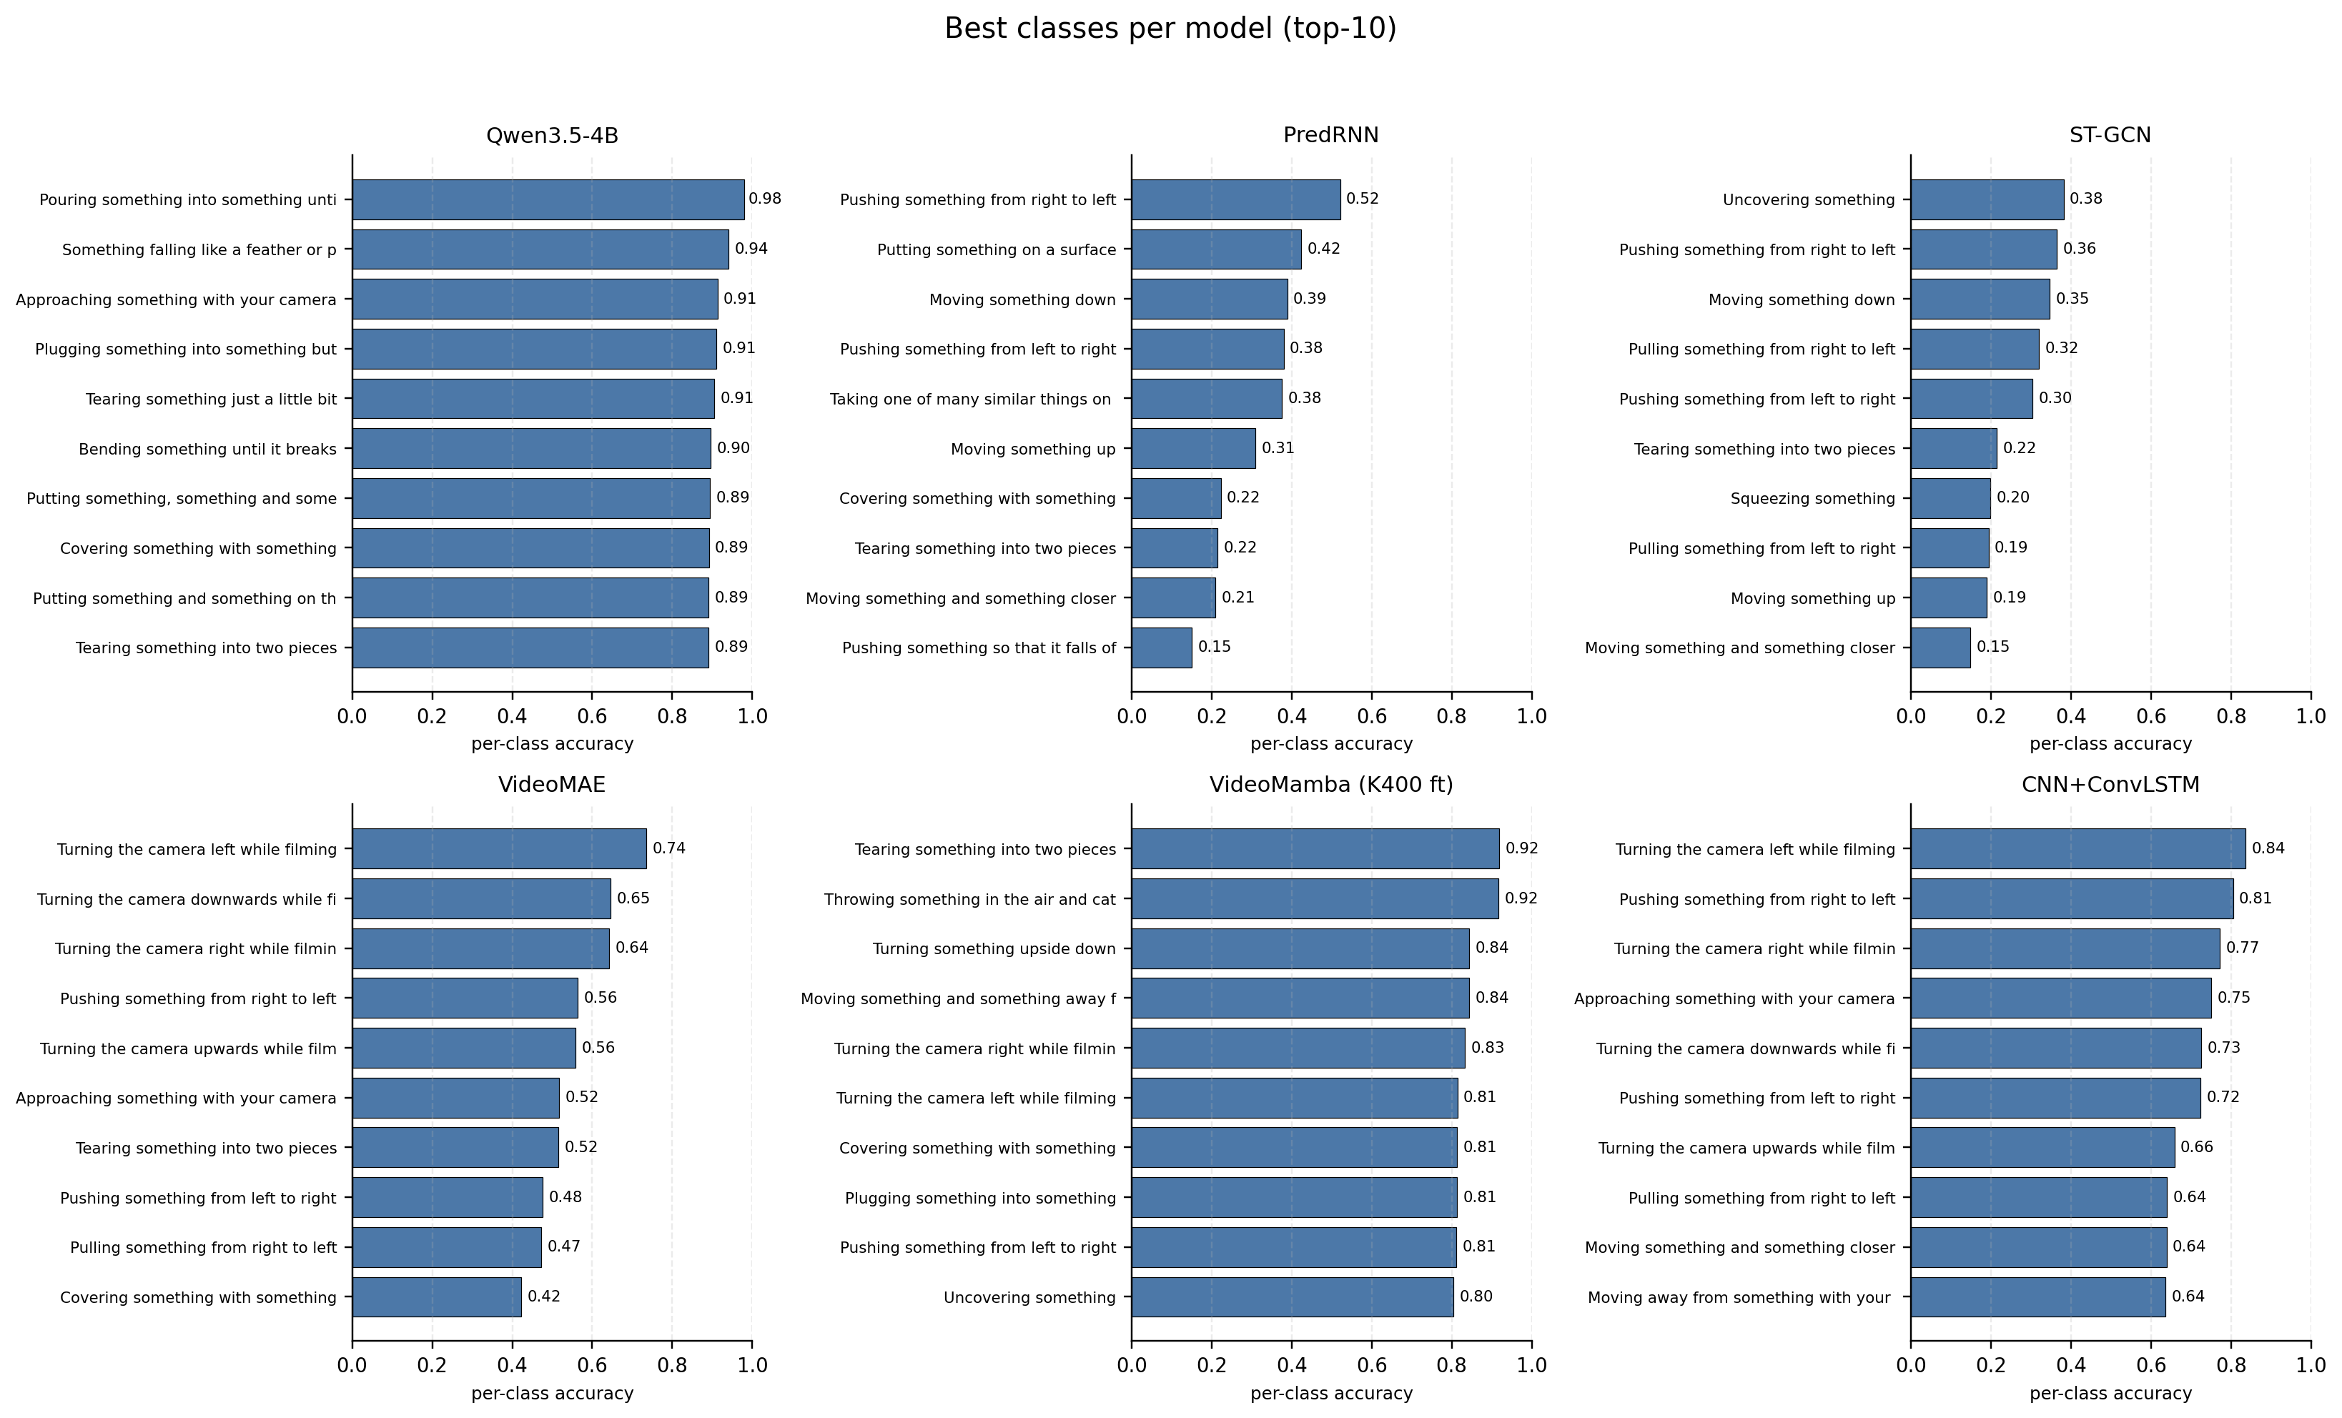
Per-class winners and losers
Camera-motion classes are easy across models. Pretending and physical-state classes are hard for everyone.

Slide 18
Discussion: four lessons
1
Pretraining dominates on SSv2.
2
Correctness before speed (the Bimamba lesson).
3
Skeleton-only is fundamentally limited.
4
VLMs are surprisingly competitive (Qwen 0.12% trainable, 58.19% top-1).

Slide 19
Conclusions and future work
■ V-JEPA on A100 + native bf16 to recover the published 69.5%
■ Full 15-epoch VideoMamba with the fused mamba_inner_fn for 58-62% top-1
■ Multi-modal fusion: ST-GCN skeleton features + R(2+1)D RGB
■ Longer Qwen training: 3 epochs would likely push past V-JEPA
■ Curriculum on the 'pretending' and physical-state classes that defeat everyone
Thanks. Questions?

